Slide 1


Slide 2

A Prayer Before Confronting Power
Quran Surah Ta Ha 20:25-28
“My Lord! Open my heart,
and ease my task for me;
and loose the knot from my tongue,
that they may understand what I am saying.”
Musa begins the work of liberation with spiritual preparation, clarity and courage.
Notes:
.

Slide 3
Why 600 years — not 400?
Pushing the starting point back to the source.
1415
1492
1506–08
1521–22
1609
1834–38
Ceuta seized
Granada falls Columbus sails
Enslaved Africans in Trinidad
African rebellions in Hispaniola / Puerto Rico
The familiar “400-year” frame
British Emancipation
“You cannot correctly analyse a problem without going back to its source.”
THE LECTURE’S THESIS
Source basis: Bilaal Abdullah, Emancipation Lecture 2026 notes, pp. 1–3.

Slide 4
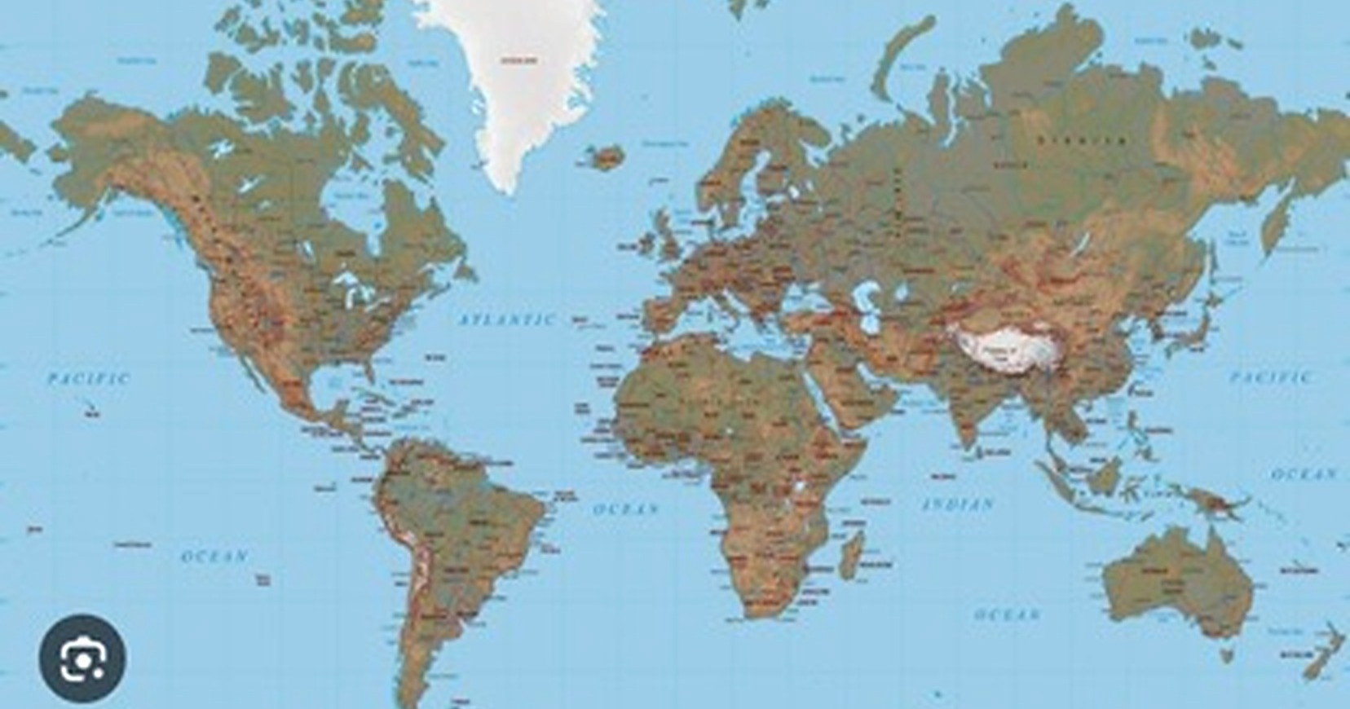
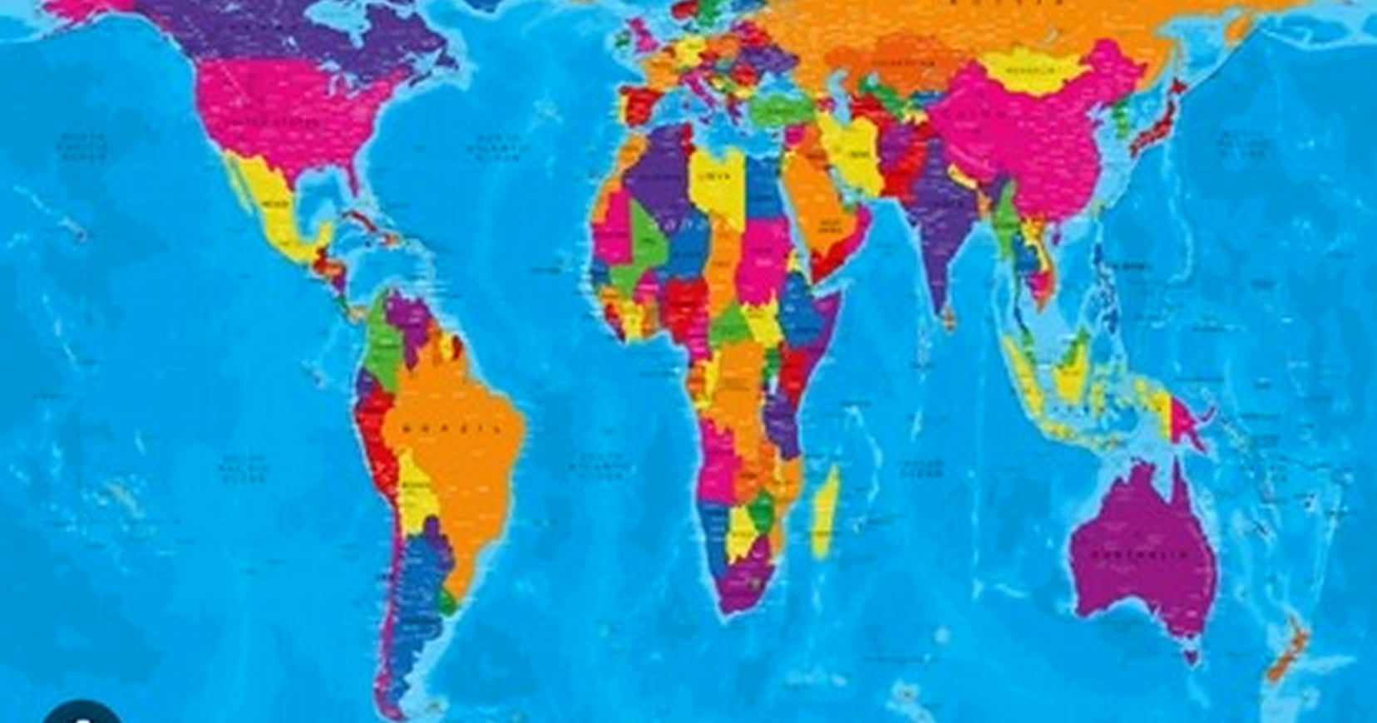
A map can teach you who is “big”
Projection is mathematics — but perception has consequences.
MERCATOR-TYPE VIEW
EQUAL-AREA / PETERS-STYLE VIEW
AFRICA ≈ 14× GREENLAND
Mercator enlarges land farther from the equator. Africa’s real area is roughly fourteen times Greenland’s.
Visual references supplied by presenter. Projection note: Mercator preserves local angles but inflates area toward the poles.

Slide 5
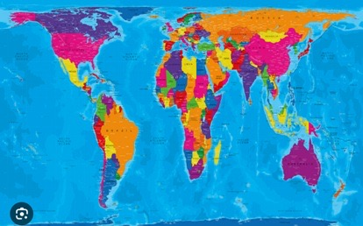
30TH ANNUAL EMANCIPATION LECTURE • 2026
ENDING 600 YEARS OF WHITE EMPIRE
Maps are never neutral
Before Empires controlled land, they learned to control how the world was seen
SIZE
CENTRE
POWER
CIVILISATION
A map is not just geography. It is a visual argument about the world.

Slide 6

30TH ANNUAL EMANCIPATION LECTURE • 2026
ENDING 600 YEARS OF WHITE EMPIRE
Before outward empire
Europe in relation to Africa, Islam, Trade and Knowledge
Muslim Spain, African rule, Arabic learning and older trade worlds complicate the story that Europe “civilised” empty places.
THE WORLD WAS NOT WAITING TO BE DISCOVERED.
Notes:
.

Slide 7

1415: The opening move
Ceuta shifts the beginning of the story
CEUTA
Portugal captures the North African port city. This as the first decisive chapter in six centuries of outward European expansion.

Slide 8

The intellectual architecture of conquest
The Doctrine of Discovery gave empire a moral vocabulary
01
Declare lands “empty”
02
Seize the land
03
Seize the wealth
04
Kill those who resist
THE SYSTEM NEEDED A JUSTIFICATION BEFORE IT BECAME A HABIT.
05
Reduce survivors to slavery

Slide 9
30TH ANNUAL EMANCIPATION LECTURE • 2026
ENDING 600 YEARS OF WHITE EMPIRE
From religious decree to racial order
The idea outlived its first religious frame.
CATHOLIC EUROPE
→
PROTESTANT EUROPE
→
WHITE SUPREMACY
Continuity of mindset: non-European peoples were treated as lesser, sub-human and destined for rule by others.
AN IDEA CAN CHANGE CLOTHES AND STILL DO THE SAME WORK.

Slide 10

The system expands
What began in Africa became a global operating system.
A doctrine first aimed at North and West Africa became a global operating system wherever European powers travelled.
THE AMERICAS
INDIA
SOUTHEAST ASIA
CHINA
AUSTRALIA
Notes:
The Doctrine of Discovery is applied to the Americas, India, China, Australia and beyond.

Slide 11
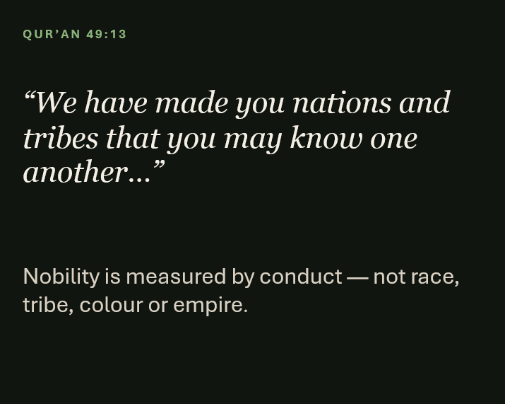
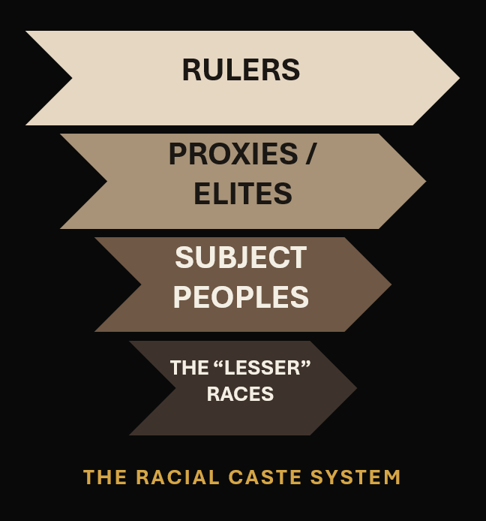
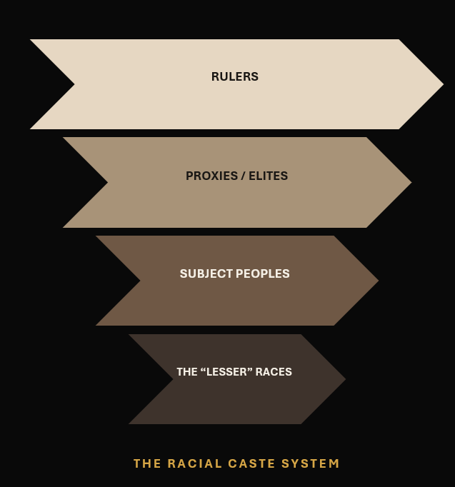
30TH ANNUAL EMANCIPATION LECTURE • 2026
ENDING 600 YEARS OF WHITE EMPIRE
Two visions of humanity
Divine equality versus a racial caste system
QUR’AN 49:13
RULERS
“We have made you nations and tribes that you may know one another…”
PROXIES / ELITES
SUBJECT PEOPLES
Nobility is measured by conduct — not race, tribe, colour or empire.
THE “LESSER” RACES
THE RACIAL CASTE SYSTEM

Slide 12

THE GLOBAL SYSTEM LANDS AT HOME
TRINIDAD IS NOT A SIDE STORY
Our national history was shaped by the same global machinery.
1506–08
1834–38
1845
1962
1976
Enslaved Africans
Emancipation
in the British Empire
Indian indentured
labour begins
Independence
Republic
EMANCIPATION WAS A MILESTONE — NOT THE FINAL DESTINATION
Source basis: lecture notes, pp. 2, 6–7 and 15.

Slide 13
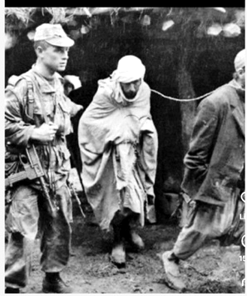
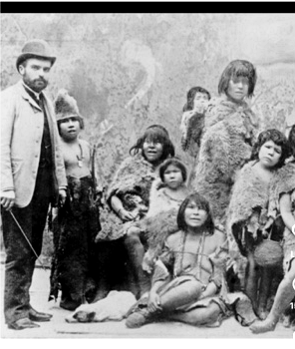
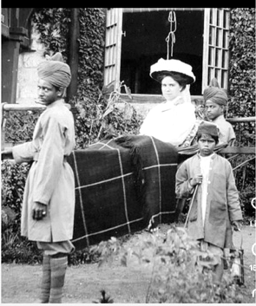
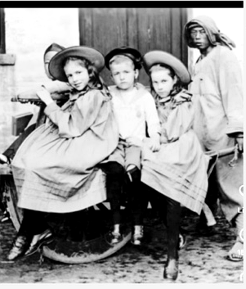
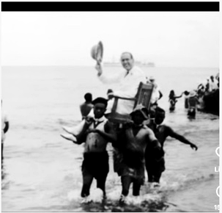
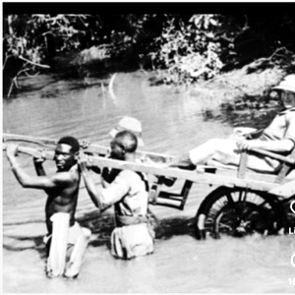
30TH ANNUAL EMANCIPATION LECTURE • 2026
ENDING 600 YEARS OF WHITE EMPIRE
Empire looked the same — with the same repeated hierarchy
Full images, separated from the collage, so the relationships remain visible.
FRENCH • ALGERIA
INDIGENOUS AUSTRALIA
BRITISH • INDIA
ENGLISH • CHINA
SPANISH • GUINEA
FRENCH • SENEGAL
THE POINT IS NOT THE COSTUME. IT IS THE RELATIONSHIP OF POWER.

Slide 14
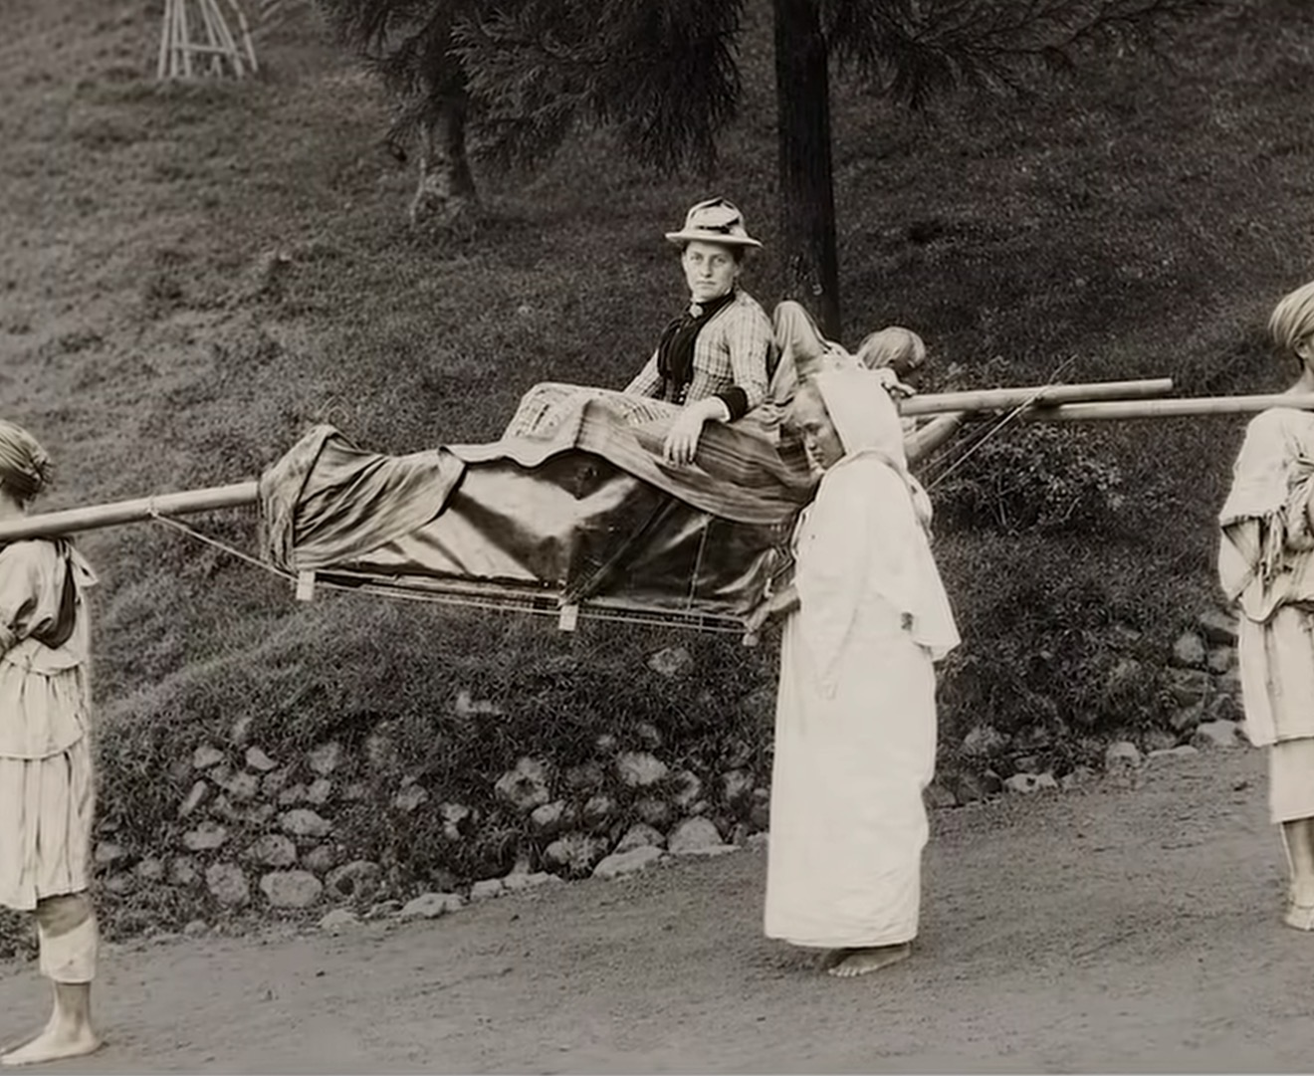
British India
PRIMARY EVIDENCE • COLONIAL HIERARCHY- THE SEDAN CHAIR
POWER WAS NOT SIMPLY EXERCISED.
IT WAS PERFORMED.
BEFORE CARS,
WE WERE THEIR VEHICLE.

Slide 15
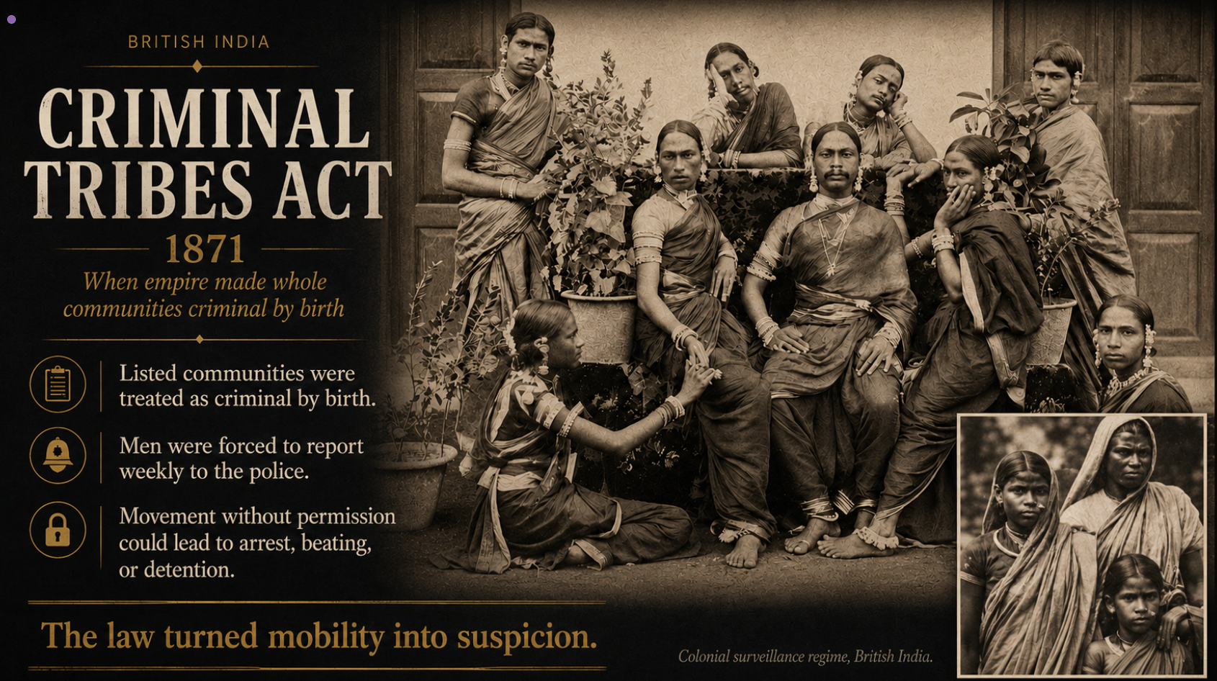
Under British Rule
Criminal By Birth.
14

Slide 16

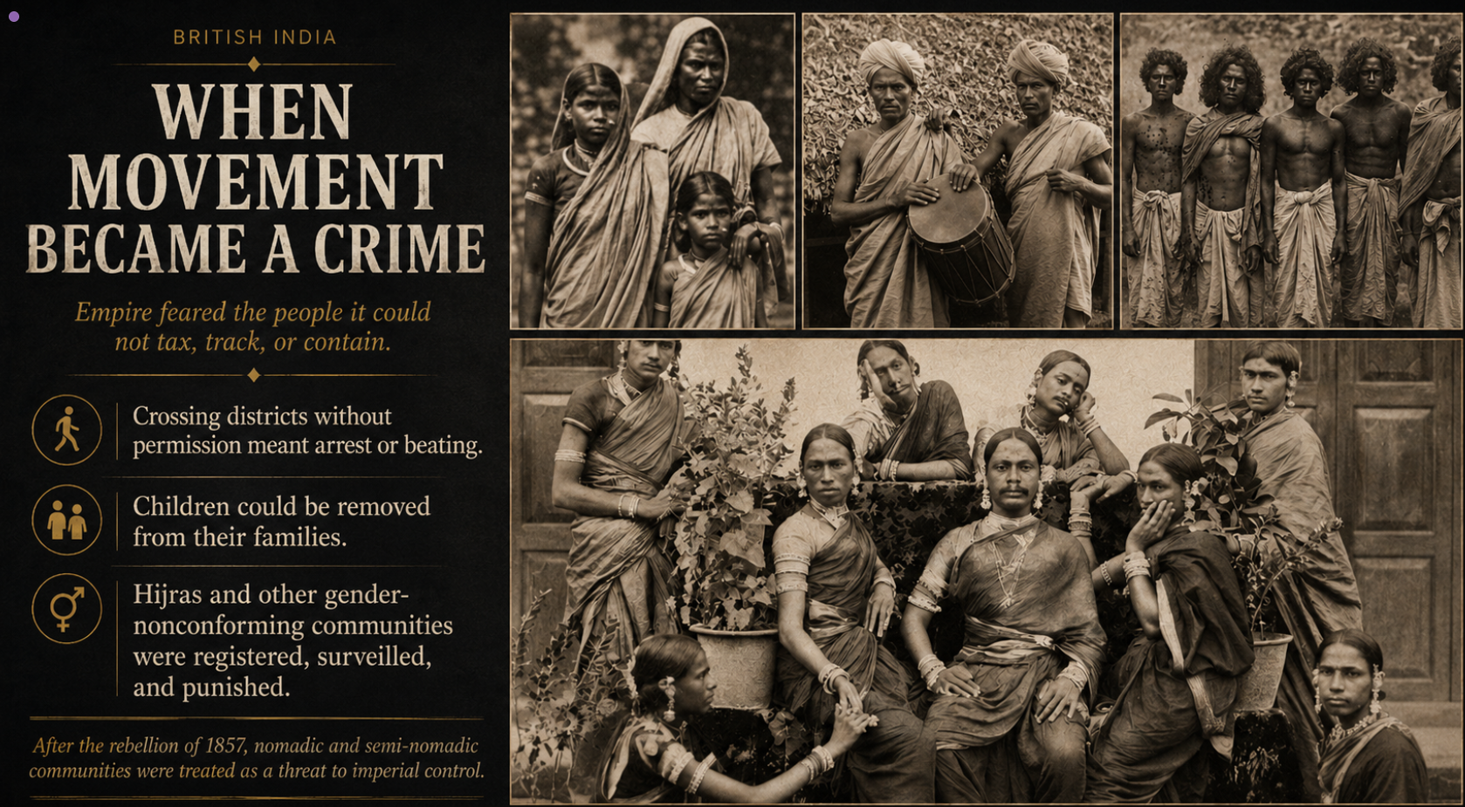

“You Shall Not Move…”
Colonial Surveillance Regime
14

Slide 17

When trade would not submit
China, opium and coercive commerce.
China was harder to subjugate because of its scale, population and wealth — so commerce, force and narcotics were combined.
COMMERCE + COERCION

Slide 18
Extraction was the business model
Colonies supplied labour, land, raw materials and markets.
SUGAR
COTTON
TEA
Caribbean
India / Americas
South Asia
RUBBER
GOLD
OIL & GAS
Africa / Asia
Africa
Global South
DEPENDENCE IN
WEALTH OUT
The lecture describes colonial wealth transfer across Africa, Asia, the Caribbean and the Americas.

Slide 19
Empire Did Not Only Rule. It Exploited.
The Exploitation of the Empire
Five places. Different mechanisms. A recurring imperial logic: control land, labour, trade and wealth.
1 / 5 • 1765–1938
2 / 5 • 1845–1852
3 / 5 • 1882–1956
4 / 5 • 1902–1963
5 / 5 • 1900s–1957
INDIA
IRELAND
EGYPT
KENYA
MALAYSIA
$45T
1M
74
7M+
83%
ESTIMATED DRAIN
DEAD IN THE GREAT FAMINE
YEARS OF BRITISH OCCUPATION
ACRES ALIENATED
EXPORT EARNINGS TO LONDON
Patnaik (2018)
food exports continued
Suez • cotton
“White Highlands”
rubber • tin • 1951
LAND. LABOUR. TRADE. RESOURCES. THE WEALTH MOVED.

Slide 20
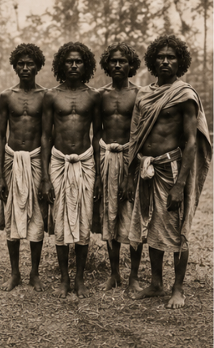
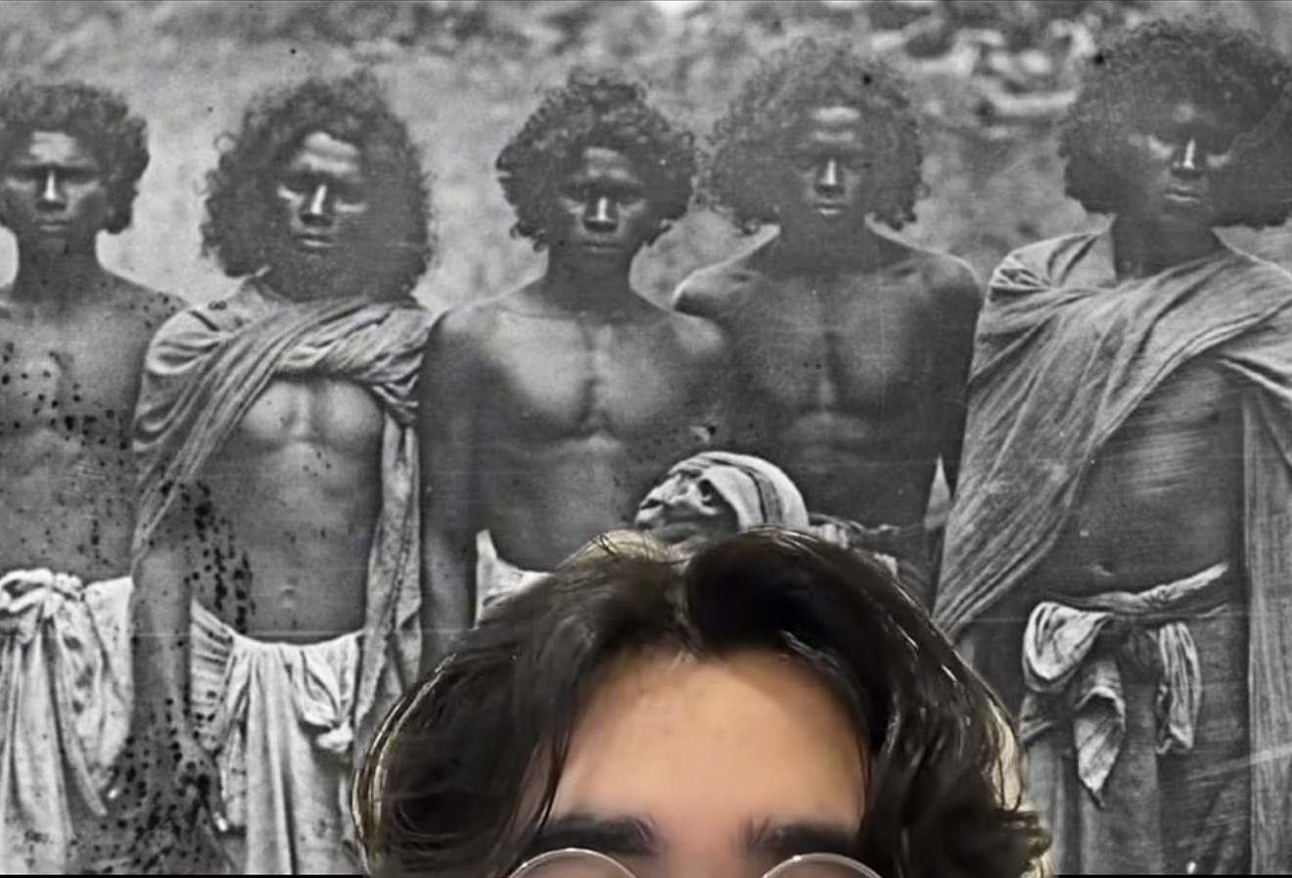
The human cost was not incidental
Violence, humiliation and dispossession disciplined colonial society.
COERCION
HIERARCHY
DISPLACEMENT

Slide 21
THE CONTINUITY ARGUMENT
THE FORM CHANGED.
THE WEB REMAINED.
SLAVERY
INDENTURESHIP
SETTLER COLONIALISM
MULTINATIONAL CORPORATIONS
FOREIGN BASES
INTELLIGENCE & SURVEILLANCE
A WORLDWIDE SYSTEM OF CONTROL
The argument is continuity: institutions evolve, but the relationship between core power and subject peoples can persist.
Illustrative artwork. System components are listed in the lecture notes, pp. 13–14.

Slide 22
30TH ANNUAL EMANCIPATION LECTURE • 2026
ENDING 600 YEARS OF WHITE EMPIRE
How the system reproduces itself
Three mechanisms of control
1 • DIVIDE & CONQUER
2 • NARRATIVE CONTROL
3 • USE PROXIES
Fragment countries. Divide communities. Exploit race, class, caste and tribe.
Shape the boundaries of acceptable thought. Hide origins. Make the system seem natural.
Recruit helpers in tiers. Reward adjacency. Let intermediaries police the masses.
“Pharaoh exalted himself in the earth and divided the people into castes…”

Slide 23
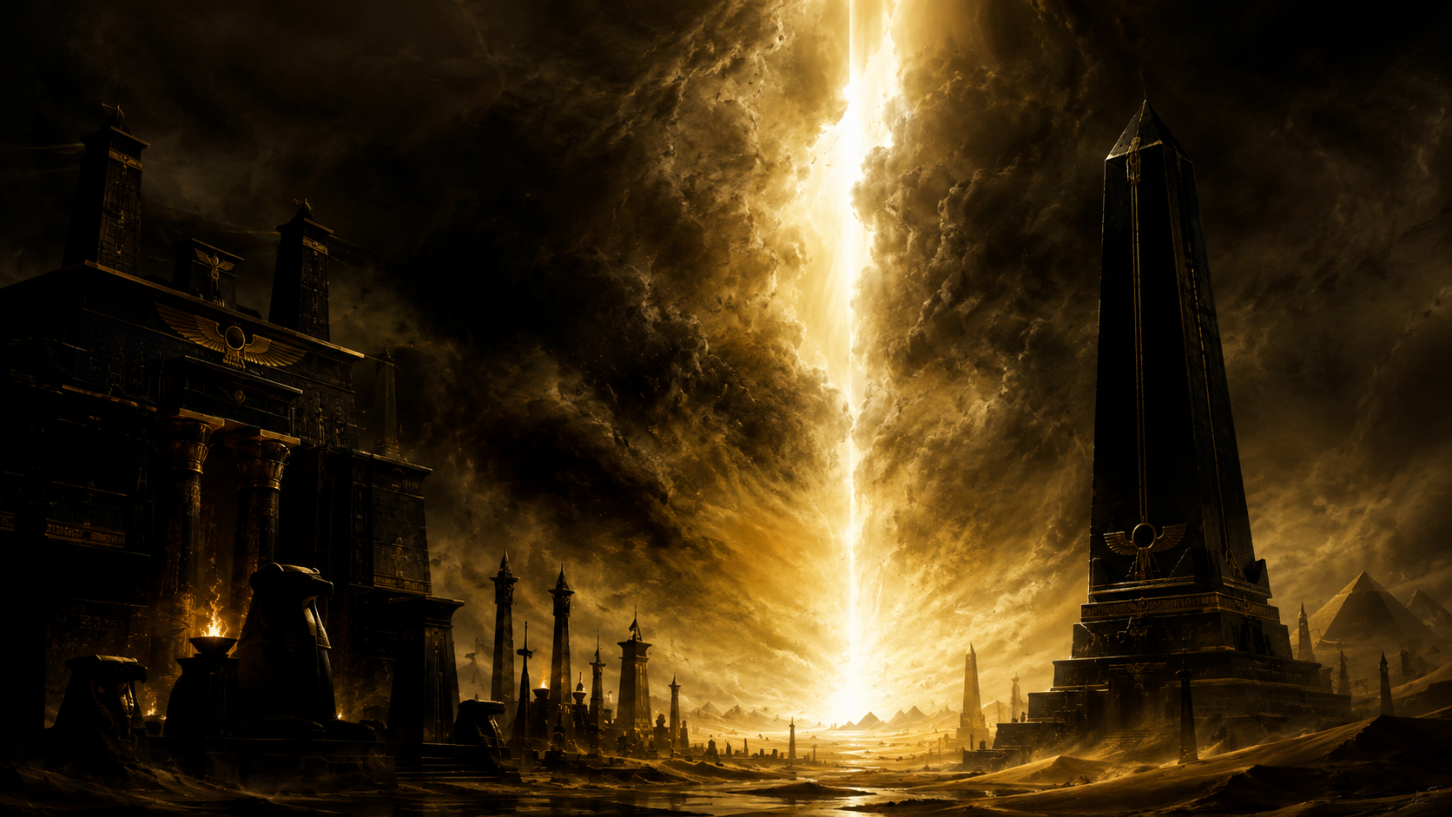
THE QUR’ANIC ARCHETYPE
PHARAOH
“
Pharaoh exalted himself in the earth and divided the people into castes…
Power that divides, degrades and makes oppression appear permanent.
QUR’AN 28:4
MUSA & HARUN
The Qur’anic response begins with faith, worship, moral renewal, patience and organised movement — before the final escape from Pharaoh’s system.
Illustrative artwork. Spiritual framework follows lecture notes, pp. 14–18.

Slide 24
FREEDOM IS A JOURNEY
EMANCIPATION WAS NECESSARY.
IT WAS NOT THE DESTINATION.
1834–38
1917
1962
1976
NOW
EMANCIPATION
INDENTURESHIP ENDS
INDEPENDENCE
REPUBLIC
INNER + COLLECTIVE FREEDOM
True freedom, means servitude to Allah alone — not merely a change of flag or constitution.
Notes:
.

Slide 25
THE WAY FORWARD
FOUR SOURCES
OF LIBERATION
REVELATION
HISTORY
Divine knowledge, moral law and the prophetic model.
Know how we arrived here; learn how others overcame trials.
ALLAH’S SIGNS
INTELLECT
Study creation, science and the environment we are entrusted to manage.
Use reason, consultation and collective thought — Aql, Shura, Panchayat.
KNOW • THINK • WORSHIP • BUILD
The response to an old system cannot be only anger. It must produce knowledge, culture, institutions and disciplined collective action.
Source basis: lecture notes, p. 16.

Slide 26

THE WORK BEGINS INSIDE — AND CONTINUES TOGETHER
FREE YOUR HEART.
CLEAR YOUR MIND.
BUILD WHAT MUST LAST.
UNDERSTAND THE ORIGIN
TEACH THE TRUTH
BUILD INSTITUTIONS
“Allah will not change the condition of a people until they change what is within themselves.”
PRACTICE SOLIDARITY
DO YOUR PART — WITHOUT HASTE
THE LECTURE’S FINAL CHALLENGE
Closing synthesis from lecture notes, pp. 18–21.
Notes:
.

